Slide 1
FINAL PROJECT
TOPIC: TASK MANAGEMENT SYSTEM
Subject : Principle of Database Management
Lecturer: Nguyễn Thị Thuý Loan
Group: 6

Slide 2

MEMBER OF OUR GROUP:
Member : Trần Đình Khôi Nguyên - ITITIU19166
Huỳnh Đức Phát - ITITIU19177
Nguyễn Việt Hoàng Nam - ITITIU19162
Nguyễn Quốc Hồng Kỳ - ITITIU19151

Slide 3

WHY THIS TOPIC ?
In today's modern life, each of us is always busy with many different jobs. “Multitasking” is a well-known phrase in today's 4.0 era. With the purpose and desire to help people manage their work in a better way, our team has come to the decision to choose a topic: “ TASK MANAGEMENT SYSTEM”

Slide 4



TECHNOLOGY:
FOR BUILDING AND CODING OUR APP:
FOR COMMUNICATION AND WORKING :

Slide 5
ENVIRONMENT SETTINGS
For MySQL Server :
https://dev.mysql.com/doc/mysql-installation-excerpt/5.7/en/windows-installation.html
For NetBean :
https://www3.ntu.edu.sg/home/ehchua/programming/howto/netbeans_howto.html
( Eclipse ) :
https://www.eclipse.org/downloads/packages/installer

Slide 6
LIBRARY FOR BUILDING APP
For UI/UX Design and Function :
https://docs.oracle.com/javase/7/docs/api/javax/swing/package-summary.html
For connection between Java and MySQL
https://www.vogella.com/tutorials/MySQLJava/article.html

Slide 7
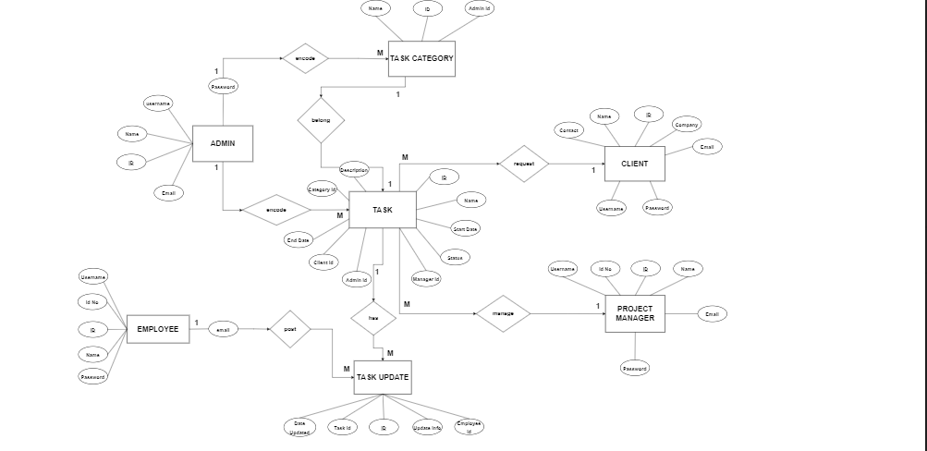
DESIGN ERD & RD

Slide 8
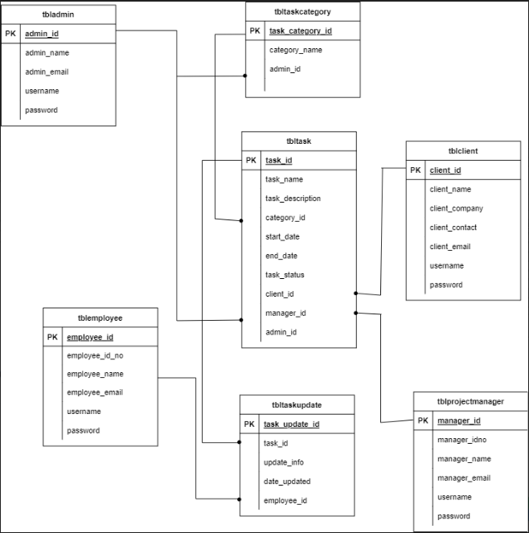

Slide 9
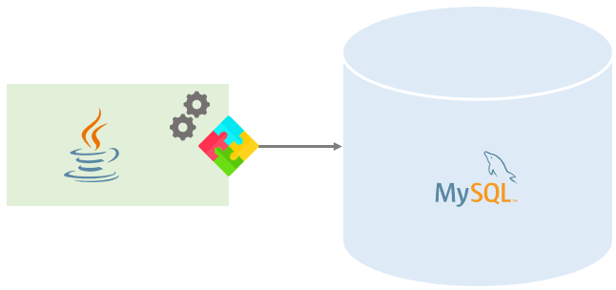
IMPLEMENT JAVA CODE & SQL QUERY

Slide 10
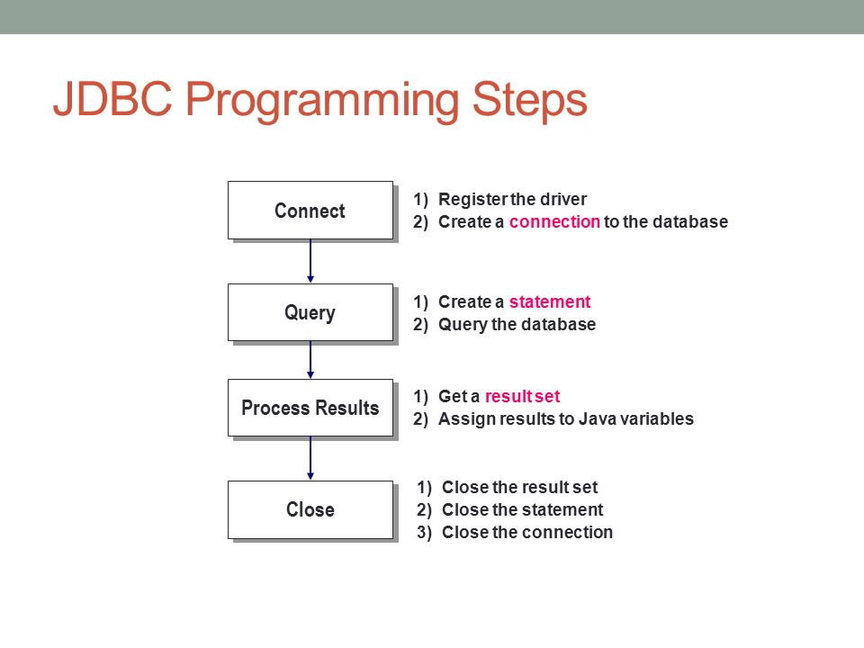

Slide 11
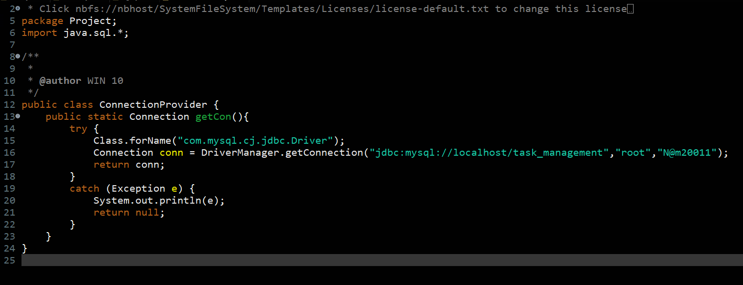
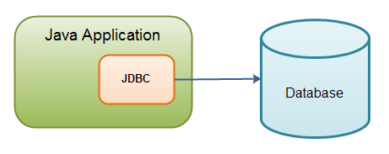

Slide 12
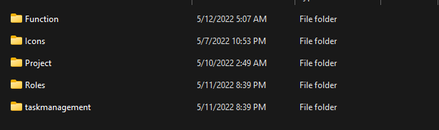

Slide 13
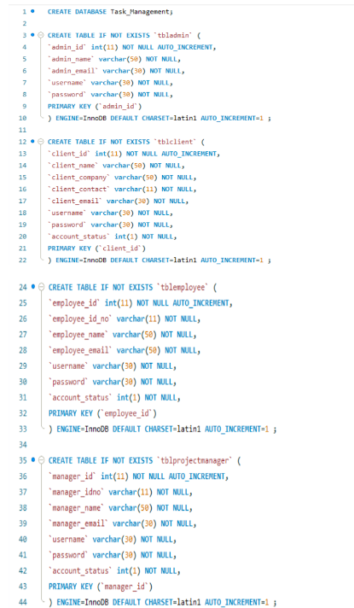
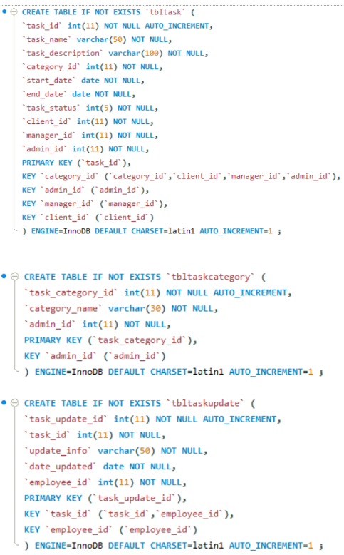

Slide 14
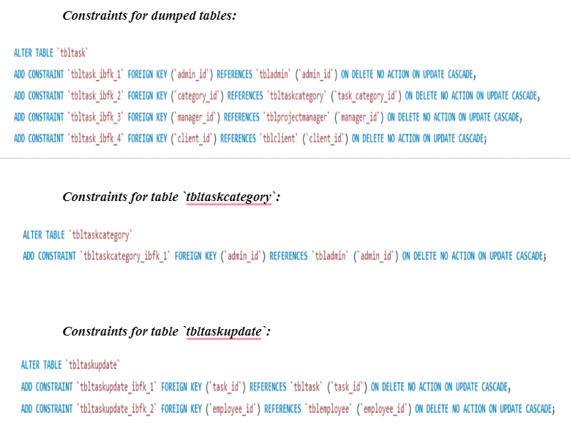

Slide 15
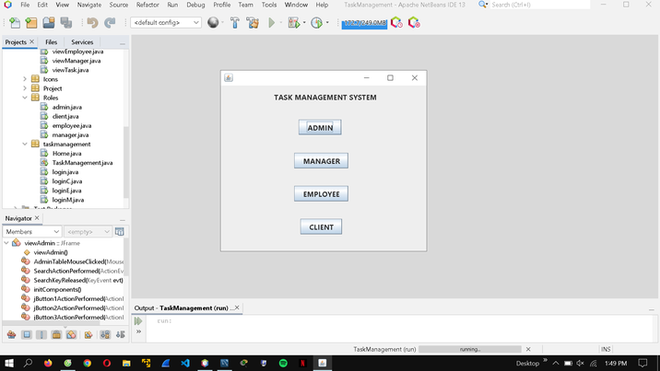
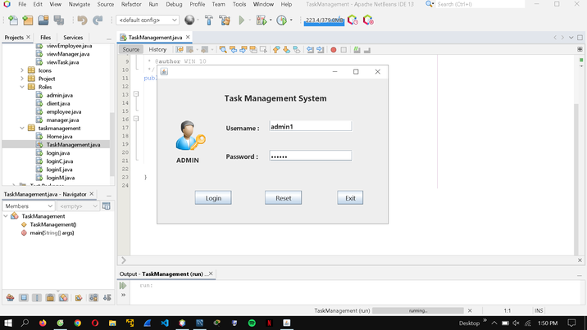
DEMO
By Nguyễn Việt Hoàng Nam

Slide 16

ANY QUESTION ?

Slide 17
REFERENCES:
For connection between java code and MySQL Query:
https://www.marcobehler.com/guides/java-databases
For UX/UI design and functions of our application:
https://www.javatpoint.com/java-swing

Slide 18

THANK FOR YOUR ATTENTION

